Slide 1
One-Sample t Test
http://www.free-powerpoint-templates-design.com

Slide 2



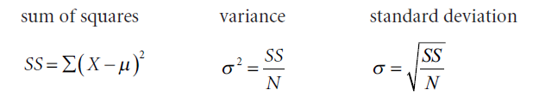
THE t-STATISTIC
The statistic used to test hypotheses about population means when σ is not known is called the t-statistic, which is given by the formula:

Slide 3
THE t-DISTRIBUTION
The t-distribution, like the z-distribution, is theoretical, symmetrical, and bell- shaped, but the appearance of the curve changes according to the size of the sample.
The particular t-distribution that we use will be based on the degrees of freedom associated with the sample.
We encountered the term degrees of freedom (df) when we used n − 1 in the denominator of the formula for estimating the population standard deviation from sample data.
When using the t-distribution for a single sample, df will also be n − 1, the size of the sample minus 1.
For instance, if your sample size is 16, df will be 15.

Slide 4
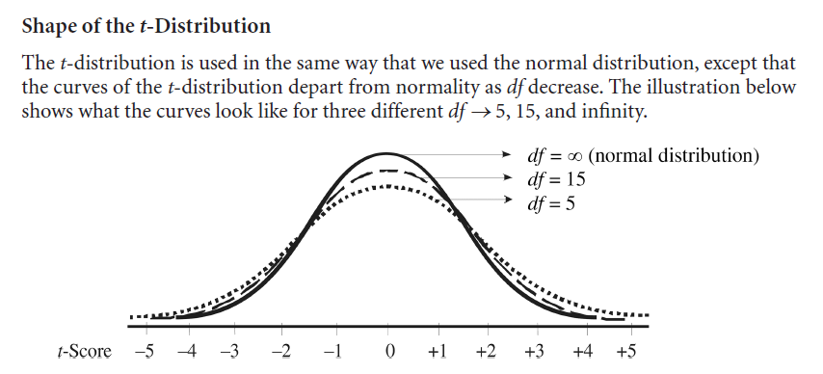

Slide 5
Critical Values for the t -Distribution
Some important features of the table are as follows:
In the left column, various degrees of freedom (df) are listed.
The first row across the top lists various levels of significance for a one-tailed test.
The second row across the top lists various levels of significance for a two-tailed test.
The remaining columns in the body of the table list the critical values necessary for rejecting H0 at the significance levels identified at the top of each column.
If the df for your particular research problem are not shown, then use the critical values associated with the next-lowest df.
For instance, if your sample size is 54, actual df would be 53 (n – 1), which is not shown.
In this case, you would use 40 to ensure that your obtained t-value falls inside the critical region.

Slide 6
ONE-SAMPLE t TEST
The one-sample t test is a test of a hypothesis about a population mean (μ) when the population standard deviation (σ ) is not known .
This test is used when researchers want to know (1) if a sample is representative of a population and/or (2) if a particular treatment or condition has a significant effect.

Slide 7
The population mean on a standardized test of critical thinking is μ = 53. A group of faculty members at a small community college underwent a 10-week training program to learn techniques designed to help students develop their critical thinking skills. After the training, the new techniques were implemented in the classrooms. The mean critical thinking score for a sample of n = 87 students exposed to the new techniques was M = 55 with SS = 6013. Do the results suggest that the training program had a significant effect? Use a two-tailed test and α = .05.
Step 1: Formulate Hypotheses
H0: μ = 53
H1: μ ≠ 53
The null hypothesis asserts that the critical thinking scores in the population, after implementation of the new techniques, would still be 53.

Slide 8
Step 2: Indicate the Alpha Level and Determine Critical Values
α = .05
df = 86
tcrit = ±2.000

Slide 9
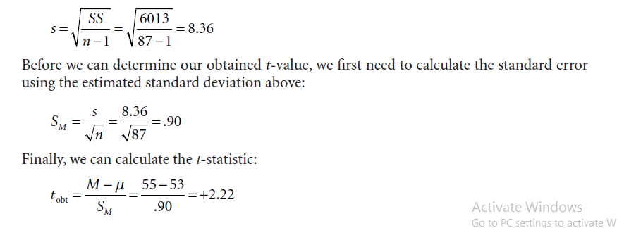
Step 3: Calculate Relevant Statistics

Slide 10
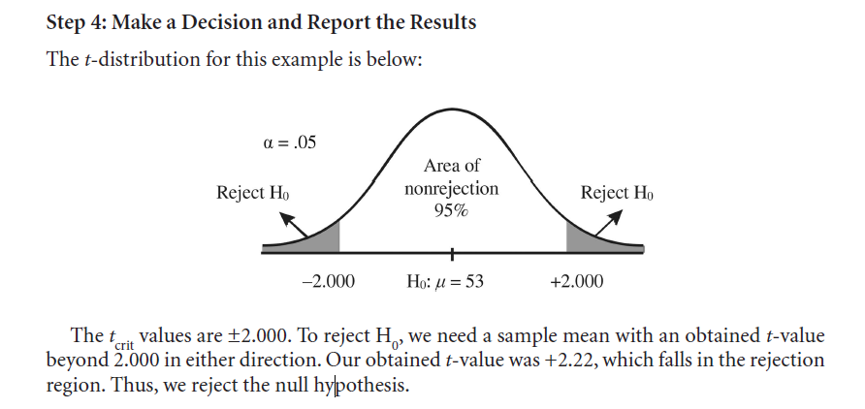

Slide 11
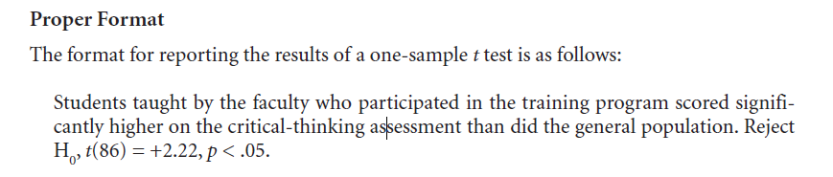

Slide 12
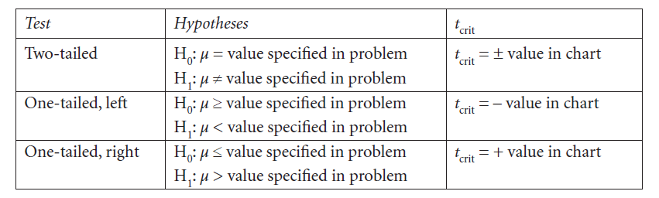
Research Question.
The mean score for golfers at the Country Oaks Golf Course is μ = 83. The manager wonders if posting a red flag at hazard sites (e.g., sand traps, ponds, gullies) will improve scores. After posting the flags at all such sites, she obtains a random sample of 25 golfers whose mean was M = 81 with SS = 788. Do the data indicate that the flags improved golf scores? (Note: Lower scores reflect better performance in golf.) Use a one-tailed test with α = .05.

Slide 13
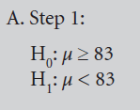
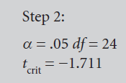
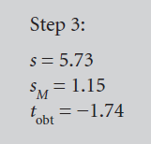
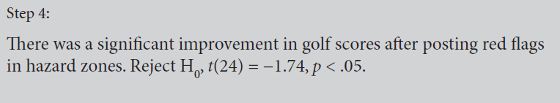

Slide 14
People in the United States report having an average of nine close friends, not counting relatives.
A psychologist believes that extroverts have more friends than the national average. The mean for a sample of n = 25 extroverts was M = 11 with a s = 6. Do extroverts have significantly more friends than the general population? Test at α = .05.

Slide 15
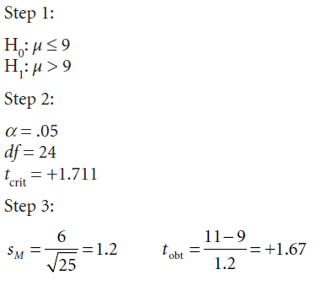
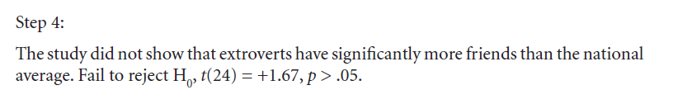

Slide 16
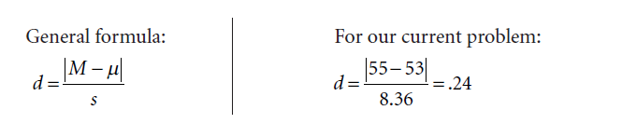
EFFECT SIZE FOR A ONE-SAMPLE t TEST
d = .20 to .49 – Small effect
d = .50 to .79 – Moderate effect
d = .80 and above – Large effect

Slide 17

ASSUMPTIONS
The applicable assumptions include the following:
• Independent and random selection of participants.
• The dependent variable is normally distributed in the population of interest.
• The dependent variable can be measured on an interval or ratio scale.

